Slide 1
Sentiment analysis using
Vader (valency aware dictionary of sentiment reasoning)
& Roberta(A Robustly Optimized -BERT Pretraining Approach)

Slide 2
VADER and RoBERTa are two different approaches for sentiment analysis, and they have several key differences
Algorithm Type:
Training:
Handling Context:
Performance:
Use Cases:

Slide 3
Algorithm Type:
VADER: VADER is a lexicon and rule-based sentiment analysis tool. It relies on a manually curated lexicon of words with associated sentiment scores to determine the sentiment of a given text. The lexicon is designed to capture the sentiment polarity and intensity of common words and phrases.
RoBERTa: is a state-of-the-art deep learning model based on the Transformer architectureIt is a pre-trained language model that learns contextual word representations from large amounts of text data using unsupervised learning. It captures complex language patterns and semantics, enabling it to understand the context and nuances of sentiment in text

Slide 4
Training:
VADER: VADER does not require training on specific datasets. Its lexicon and rules are pre-defined and fixed.
RoBERTa: RoBERTa is a machine learning model that requires pre-training on a large corpus of text to learn contextual representations. After pre-training, it can be fine-tuned on specific tasks like sentiment analysis.

Slide 5
Handling Context:
VADER: VADER uses a lexicon and rules to analyze individual words in a text and aggregates their sentiment scores. However, it does not consider the context or syntax of the entire sentence.
RoBERTa: RoBERTa is designed to understand the context and syntax of the entire sentence or document, which allows it to capture more nuanced sentiment relationships between words and phrases.

Slide 6
Performance:
VADER: VADER is generally fast and efficient because it relies on a fixed lexicon and simple rules. However, its performance may be limited, especially when dealing with sarcasm, irony, or context-dependent sentiments.
RoBERTa: RoBERTa is a more sophisticated model that can potentially achieve higher accuracy on sentiment analysis tasks, particularly in complex and diverse text data. However, it requires more computational resources and time for training and inference compared to VADER.

Slide 7
Use Cases for VADER: VADER is well-suited for quick sentiment analysis tasks, especially for social media text and informal language where sentiment expressions can be straightforward.
Social Media Monitoring: VADER is widely used for sentiment analysis on social media platforms like Twitter, Facebook, and Instagram. It can quickly analyze large volumes of social media posts, comments, and tweets to gauge public sentiment towards a product, brand, or event.
Customer Feedback Analysis: VADER can be employed to analyze customer feedback, reviews, and comments on websites, forums, or review platforms. It helps businesses gain insights into customer satisfaction and identify areas for improvement.
Political Sentiment Analysis: VADER is often used in political analysis to gauge public sentiment towards political candidates, policies, or events. It can provide real-time sentiment tracking during election campaigns or important political events.
Brand Monitoring and Reputation Management: Businesses can use VADER to monitor online mentions and discussions about their brand. It helps in understanding how customers perceive the brand and manage the brand's online reputation.
Social Listening and Market Research: VADER is valuable for social listening and market research to track trends, consumer preferences, and sentiment shifts in specific industries or markets.

Slide 8
Use Cases for RoBERTa: RoBERTa: RoBERTa is suitable for a wide range of natural language processing tasks, including sentiment analysis, and can handle various types of text data, including formal and technical language.
Domain-Specific Sentiment Analysis: RoBERTa can be fine-tuned on domain-specific datasets to perform sentiment analysis in specialized industries like healthcare, finance, or legal, where the language and sentiment expressions might be specific to the domain.
Sentiment Analysis on News Articles: RoBERTa can be used to analyze sentiment in news articles, editorials, and opinion pieces to understand the sentiment and tone of media coverage on various topics.
Product and Service Reviews: RoBERTa can handle a wide variety of language patterns and sentiment expressions, making it suitable for sentiment analysis on detailed product or service reviews, where sentiments may be more nuanced.
Sentiment Analysis in Financial Markets: RoBERTa can be employed to analyze sentiments in financial news, social media discussions, and analyst reports to gain insights into market sentiment and make informed investment decisions.
Sentiment Analysis in Healthcare: RoBERTa can be fine-tuned for analyzing sentiments in patient reviews, medical records, and healthcare surveys to understand patient satisfaction and sentiments towards healthcare providers.
Multilingual Sentiment Analysis: RoBERTa's multilingual capabilities allow it to perform sentiment analysis on texts in various languages, making it useful for applications in multilingual settings or global businesses.

Slide 9
Customization:
VADER: Customizing VADER's lexicon requires manual curation of new words and their associated sentiment scores. This process can be time-consuming and may not cover all domain-specific terms.
RoBERTa: RoBERTa can be fine-tuned on domain-specific labeled data to tailor it for specific applications, allowing for more accurate and domain-aware sentiment analysis.

Slide 10
In summary
VADER is a simple and efficient tool for sentiment analysis that relies on a fixed lexicon and rules, while RoBERTa is a more sophisticated deep learning model that requires pre-training and can capture complex contextual relationships in text. The choice between VADER and RoBERTa depends on the specific task requirements, available resources, and the desired level of accuracy and flexibility needed for sentiment analysis.

Slide 11
Few of the many advanced NLP models that have been developed since BERT's introduction.
RoBERTa (A Robustly Optimized BERT Pretraining Approach): As mentioned earlier, RoBERTa is an improved version of BERT with modifications in the pretraining process, larger batch size, and longer training. It achieves better performance on various NLP tasks.
XLNet (Generalized Autoregressive Pretraining for Language Understanding): XLNet is a transformer-based model that combines the strengths of autoregressive models (like GPT) and bidirectional models (like BERT). It overcomes BERT's limitation of considering only left-to-right or right-to-left context and enables more comprehensive context modeling.
ALBERT (A Lite BERT for Self-supervised Learning of Language Representations): ALBERT introduces parameter reduction techniques to reduce the model size while maintaining performance. It significantly reduces the number of parameters in BERT, making it computationally efficient without sacrificing accuracy.

Slide 12
GPT-3 (Generative Pre-trained Transformer 3): Developed by OpenAI, GPT-3 is a massive language model with 175 billion parameters. It is capable of generating human-like text and demonstrates impressive performance across various NLP tasks without task-specific fine-tuning.
ELECTRA (Efficiently Learning an Encoder that Classifies Token Replacements Accurately): ELECTRA introduces a new training method called "replaced token detection," where it tries to predict which tokens have been replaced by a masked language model during training. This method allows for more efficient training and better utilization of data.
BART (Bidirectional and Auto-Regressive Transformers): BART is a denoising autoencoder that combines the bidirectional training of BERT with the auto-regressive generation of GPT. It can be used for both sequence-to-sequence tasks and denoising autoencoder tasks.

Slide 13
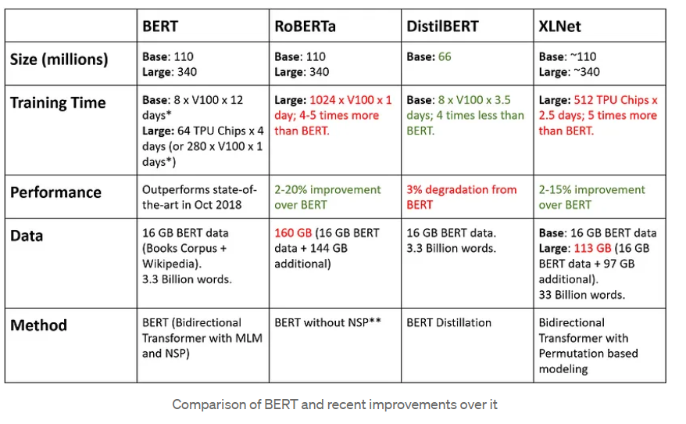

Slide 14
THANK YOU !

Slide 15
BERT, which stands for "Bidirectional Encoder Representations from Transformers," is a powerful natural language processing (NLP) model introduced by researchers at Google AI in 2018. It represents a significant advancement in the field of NLP and has been instrumental in numerous downstream NLP tasks due to its ability to capture contextualized word representations.
Intuition Behind BERT:
The main intuition behind BERT is to address the limitations of traditional context-independent word embeddings like Word2Vec and GloVe. These embeddings represent words as fixed vectors, ignoring the context in which the word appears. For example, the word "bank" could have different meanings depending on the context (e.g., "bank of a river" vs. "bank as a financial institution").
BERT's innovation lies in its bidirectional training approach using the Transformer architecture. This approach allows the model to consider both left and right contexts of each word when generating its contextualized word embeddings. BERT is "pretrained" on a large corpus of text data by predicting missing words in sentences. This pretraining process is known as the "Masked Language Model" (MLM).

Slide 16
Masked Language Model (MLM):
During the MLM pretraining, BERT takes a sentence and masks some of the words (typically 15% of the words) with a special token "[MASK]" or substitutes them with a random word. The model's objective is to predict the original masked words based on the surrounding context. By training on this masked prediction task, BERT learns to capture deep contextual relationships between words, resulting in contextually rich word embeddings.

Slide 17
Key Features of BERT:
Bidirectional Context:
BERT's bidirectional approach allows it to consider both left and right contexts when generating word embeddings. This bi-directional attention helps the model better understand the relationship between words in a sentence.
Transformer Architecture:
BERT is built upon the Transformer architecture, which enables efficient parallelization and capturing long-range dependencies in text.
Pretraining and Fine-Tuning:
BERT is pretrained on a large dataset to learn general language representations. After pretraining, it can be fine-tuned on specific downstream tasks with relatively small amounts of labeled data to achieve excellent performance on tasks like text classification, named entity recognition, sentiment analysis, question answering, and more.
Contextualized Word Embeddings:
BERT's word embeddings are contextualized, meaning they vary based on the context of the word in the sentence. This contextualization is key to its superior performance on various NLP tasks.
Open Source and Transfer Learning:
BERT's pretrained model is available as open-source, allowing researchers and developers to use it as a starting point for a wide range of NLP tasks. Transfer learning from BERT has become a common practice in the NLP community.

Slide 18
In summary, BERT's bidirectional training approach using the Transformer architecture and the Masked Language Model (MLM) pretraining enable it to learn contextually rich word representations. This has made BERT a groundbreaking model, revolutionizing NLP research and serving as the foundation for various state-of-the-art NLP models and applications.

Slide 19
Autoregressive models are a class of statistical models that generate data by modeling the probability distribution of each data point conditioned on previous data points. In other words, the model generates data sequentially, one data point at a time, based on the probability distribution of the current data point given the previous ones.
Intuition:
The term "autoregressive" comes from the idea that each data point in the sequence is considered an "auto-regression" of the previous ones. In simple terms, the model predicts the next data point in the sequence based on the history of the sequence up to that point.
Formal Definition:
In the context of time series data, an autoregressive model of order p (often denoted as AR(p)) predicts the current data point (yt) based on the p previous data points (yt-1, yt-2, ..., yt-p) as follows:
yt = β0 + β1 * yt-1 + β2 * yt-2 + ... + βp * yt-p + εt
where:
yt is the current data point.
β0, β1, ..., βp are the model coefficients.
εt is the error term, representing random noise or unexplained variability.
In autoregressive models, the coefficients (β0, β1, ..., βp) are estimated from the training data to best fit the historical patterns in the sequence.

Slide 20
Applications:
Autoregressive models have various applications in time series analysis, signal processing, and natural language generation, among others. In natural language processing (NLP), autoregressive language models like GPT (Generative Pre-trained Transformer) generate text by predicting the next word in a sequence based on the previous words. This sequential generation process allows the model to create coherent and contextually appropriate text.
Autoregressive models are powerful tools for capturing temporal dependencies and sequential patterns in data, making them well-suited for tasks that involve time series or sequential data generation. However, they may have limitations when dealing with long sequences or capturing long-range dependencies, which is where other architectures like transformers and bidirectional models (e.g., BERT) have demonstrated their strengths.

Slide 21
XLNet's intuition lies in overcoming the limitations of existing language models like BERT and GPT by combining the strengths of both autoregressive and bidirectional models. It achieves this through a novel training objective that allows it to model all possible permutations of the input text, effectively capturing bidirectional context while maintaining the advantages of autoregressive models.
Intuition Behind XLNet:
XLNet's Training Objective:
XLNet introduces a novel permutation-based training objective that combines the best of both worlds - bidirectional and autoregressive models. Instead of masking random words as in BERT or generating text sequentially as in GPT, XLNet generates text by considering all possible permutations of the input tokens.
powerful language model that achieves state-of-the-art performance on a wide range of NLP tasks, offering improved context modeling and fluency in text generation.

Slide 22
For example, given a sentence "I love XLNet," XLNet will consider various permutations such as:
"I love XLNet"
"XLNet love I"
"love I XLNet"
"love XLNet I"
...
The model is trained to predict the likelihood of each word given its context, considering all possible permutations. This approach allows XLNet to capture bidirectional context like BERT but also enables it to capture autoregressive relationships within each permutation, similar to GPT.
Benefits of XLNet:
Context Modeling: XLNet can effectively capture both bidirectional and autoregressive context. This means it understands the relationships between all words in the sentence and generates text more fluently and contextually.
No Masking: Unlike BERT, XLNet does not need to mask words during training, which can lead to information loss. It leverages the full context of the sentence without the need for masking.
Better Generalization: By considering all permutations, XLNet can generalize better to different sentence structures and handle long-range dependencies in text more effectively.
XLNet's combination of bidirectional and autoregressive training makes it a powerful language model that achieves state-of-the-art performance on a wide range of NLP tasks, offering improved context modeling and fluency in text generation.

